Slide 1
From FP32 to 2 bits:
Dual-Drive of Hardware & Models
Edge AI System
2025/7/2
Notes:
什么是GPU？它的架构有哪些？
什么是SM？

Slide 2
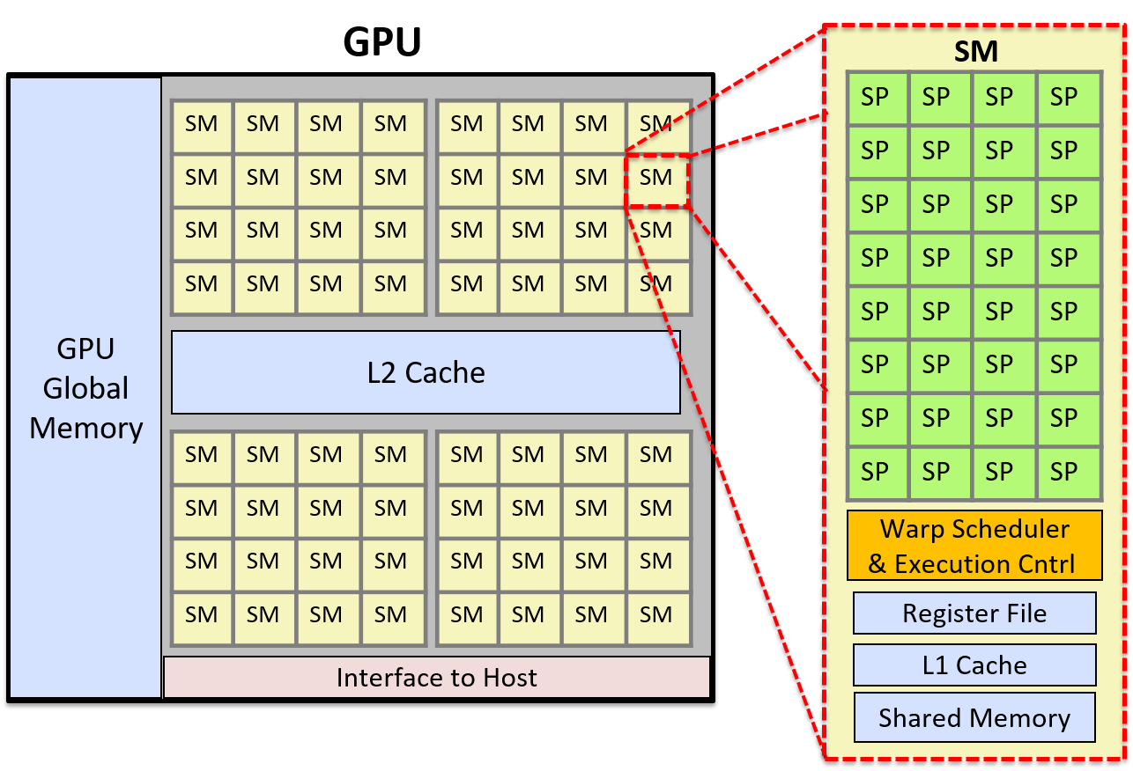
NVIDIA GPU Architecture
Tensor Core
CUDA Core
SM: Streaming Multiprocessor; SP: Streaming Processor
Notes:
什么是GPU？它的架构有哪些？
什么是SM？

Slide 3
Three Typical Compute-Cluster
Compute-Cluster | Primary Purpose | Typical Numeric Precision | Compute Pattern
High-Performance Computing | Numerical Equation Solving | FP64 | Dense FP math, tightly-coupled vector
AI Computing | AI model training & inference | FP16 / BF16 / FP8 / FP4 | Tensor-centric, matrix-accel, deep parallelism
Cloud Data Center | Internet & cloud services | INT32 / FP32 | Latency-tolerant, thread/IO-bound, scale-out
Notes:
什么是GPU？它的架构有哪些？
什么是SM？

Slide 4
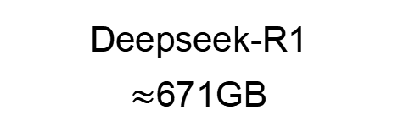
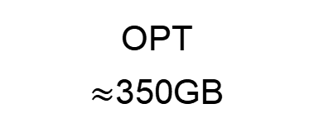
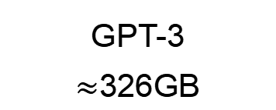
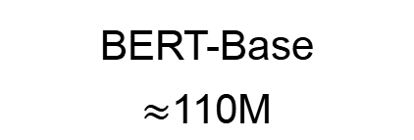
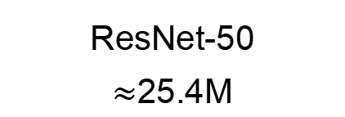
Co-Evolution of AI Models and NVIDIA GPU
Model Evolution
ResNet-50
$≈$25.4M
BERT-Base
$≈$110M
GPT-3
$≈$326GB
OPT
$≈$350GB
Deepseek-R1
$≈$671GB
Year
2016
2018
2020
2022
2024
GPU Architecture
Volta: V100
Turing: T4
Ampere: A100
Hopper: H100
Blackwell: B200
Tensor Core Precision
FP32
FP16/BF16
INT8/INT4
FP8
FP6/FP4
Memory
16GB
32GB
80GB
96GB
192GB
Notes:
每一代GPU有哪些更新？他是否是顺应模型时代的？
要不要引入说AI人工智能计算不需要高精度？加一页ppt

Slide 5
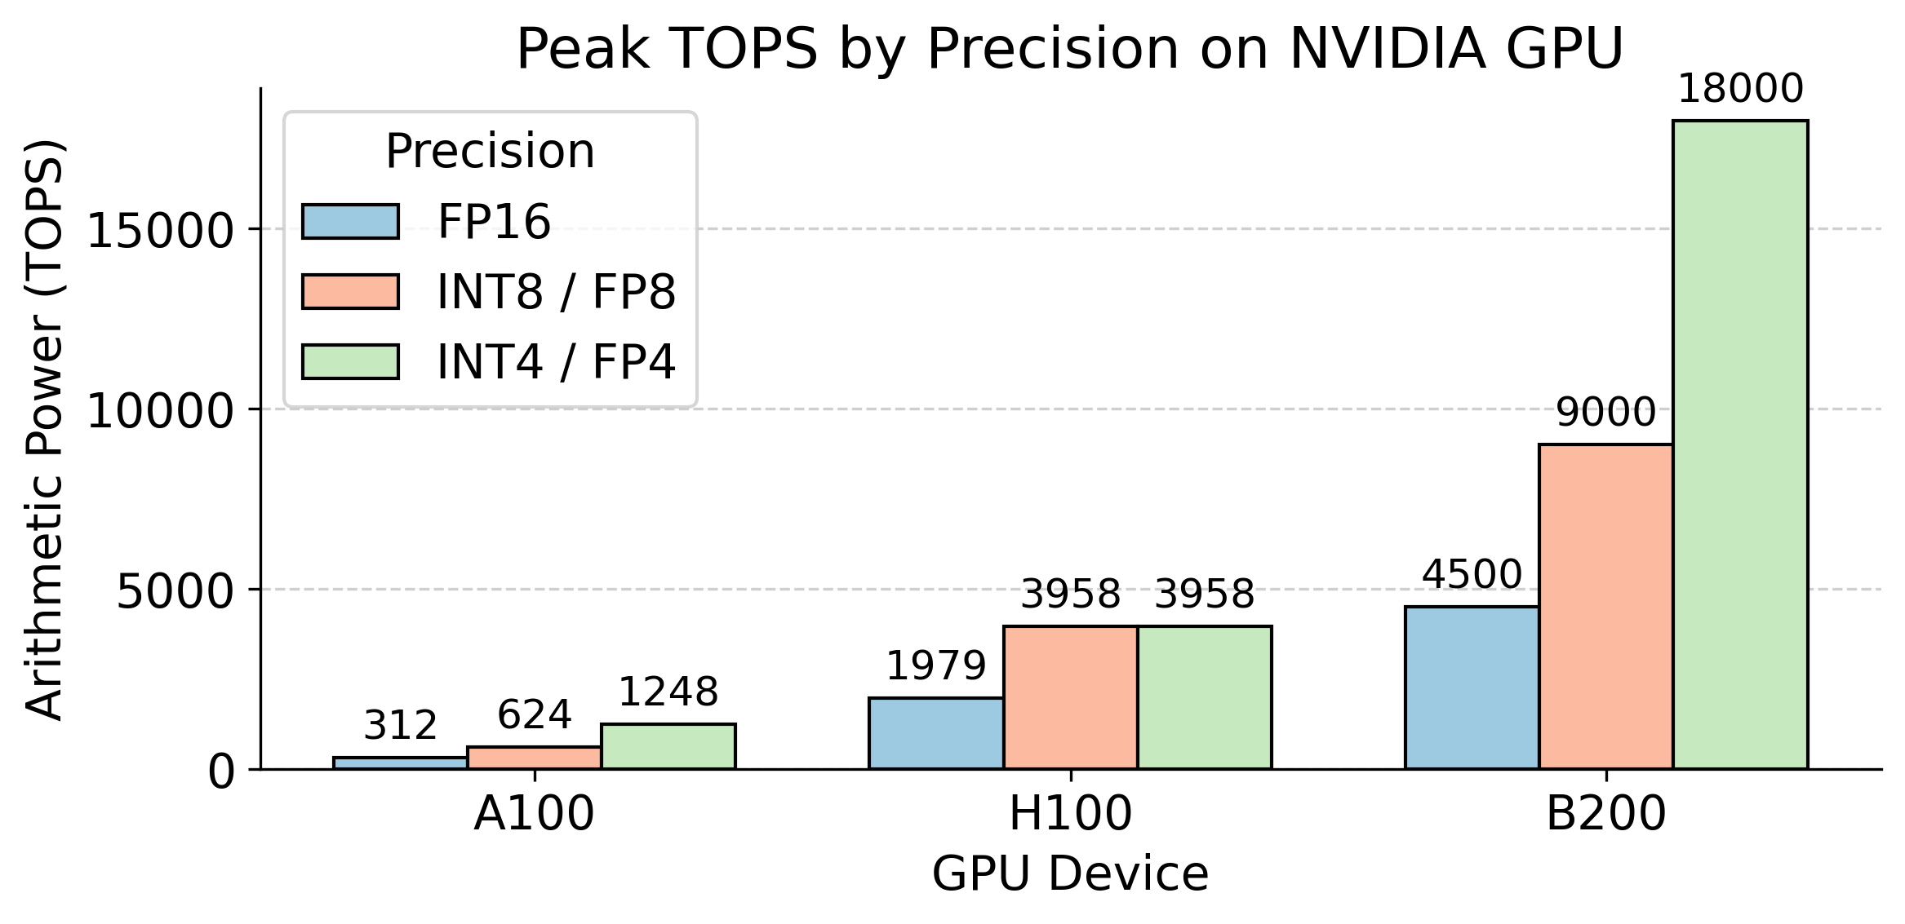
Why lower precision better?
Lower precision operations allow higher compute density throughput on GPU
Notes:
为什么在精度位宽上也要有更新？他能带来的好处是什么？

Slide 6
Deepseek-V3 FP8 Training
Forward
Backward
Optimizer
BF16
BF16
FP32
To FP8
Input
Gradient
Weight
Gradient
FP32
Input
To FP8
Optimizer States
Master
Weights
BF16
Fprop FP8 GEMM
Weight
Dgrad FP8 GEMM
Wgrad FP8 GEMM
To FP8
To FP8
To FP8
Output
Output
Gradient
To FP8
BF16
BF16
To BF16

Slide 7
Towards 4/8bit Training and 2/4bit Inference at Scale
FP8 Training:
ICLR 2025 Spotlight
FP4 Training:
ICML 2025
Staged Asymmetric KV Cache Quantization:
KIVI
Hardware–Software Co-Designed KV Cache Quantization:
Oaken
Scaling FP8 training to trillion-token LLMs, ICLR 2025 Spotlight
Optimizing Large Language Model Training Using FP4 Quantization, ICML 2025
KIVI: A Tuning-Free Asymmetric 2bit Quantization for KV Cache, ICML 2024
Oaken: Fast and Efficient LLM Serving with Online-Offline Hybrid KV Cache Quantization, ISCA 2025

Slide 8
Trend 1: Low Floating-Point Training

Slide 9
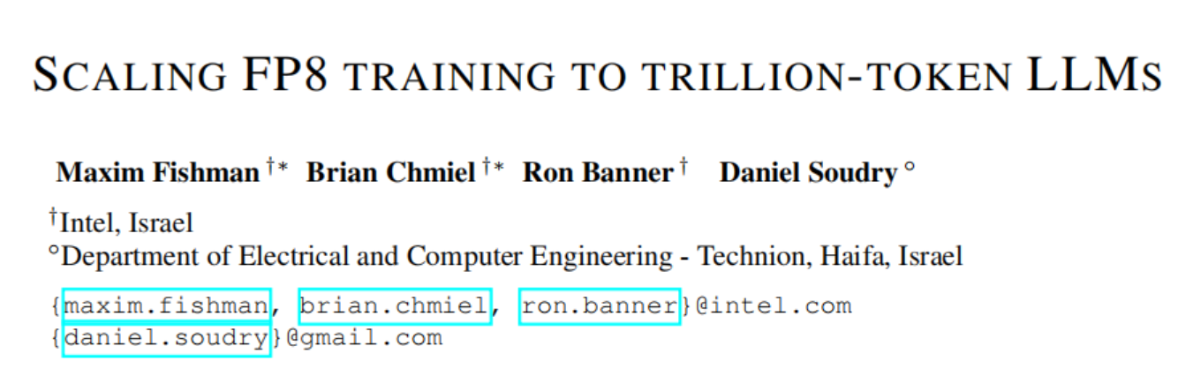
ICLR 2025 Spotlight
Intel

Slide 10
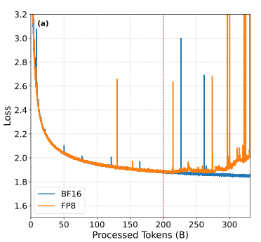
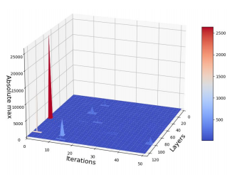
Scaling FP8 training to trillion-token LLMs
Problem: After training 200B tokens, the loss of FP8 training is destabilizing
Why do these outliers appear during training?

Slide 11
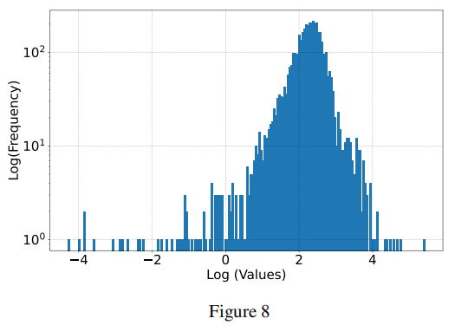
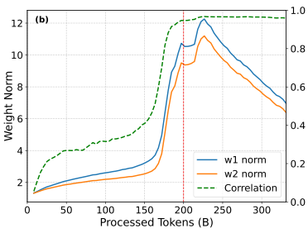
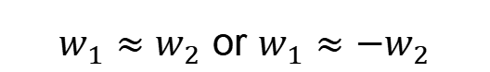
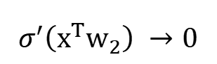
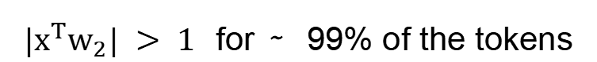
Scaling FP8 training to trillion-token LLMs
SwiGLU is the most common activation function in modern LLMs like LLaMA:
$|{x^{T}w}_{2}| > 1$ for ∼ 99% of the tokens
$$σ^{′}\left({x^{T}w}_{2}\right) →0$$
$w_{1}≈w_{2}$ or $w_{1}≈{−w}_{2}$
Activation is amplified by a factor of squares

Slide 12
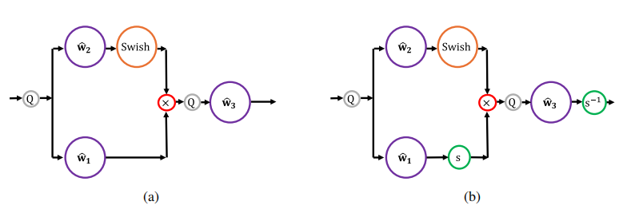
Scaling FP8 training to trillion-token LLMs
Smooth-SwiGLU:
Exceeds the range of FP8
Traditional quantized FFN layer
Current quantized FFN layer with smooth scales

Slide 13
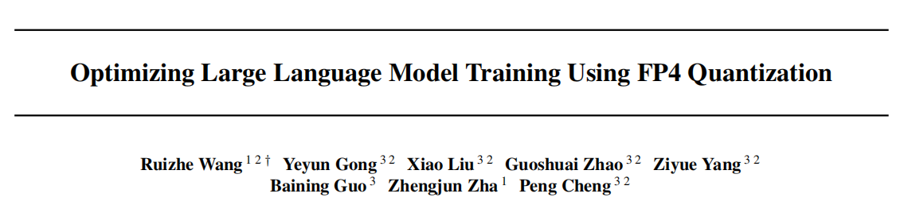
ICML 2025
MSRA

Slide 14
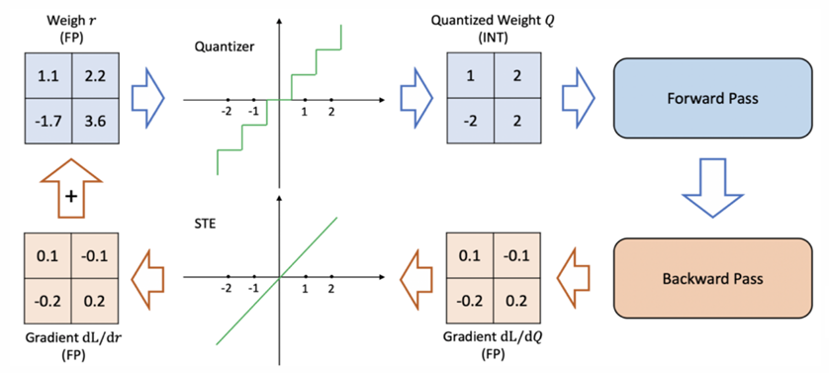
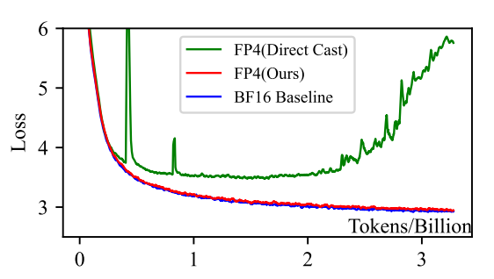
Optimizing Large Language Model Training Using FP4 Quantization
Problem: quantization function f(x) is not derivable, but the traditional straight through estimator (STE) in back propagation would assume that f(x) = x
STE cannot express the true nonlinearity introduced by quantized approximations

Slide 15
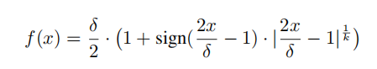
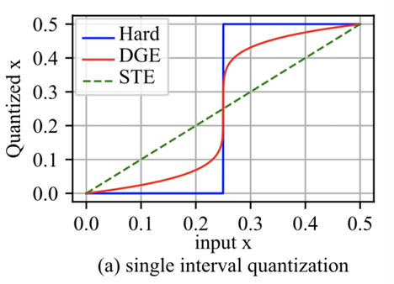
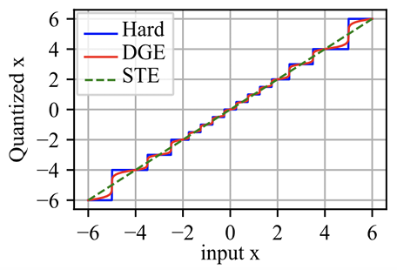
Optimizing Large Language Model Training Using FP4 Quantization
Differentiable gradient estimator: a gradient correction term derived from a differentiable approximation of the quantization function

Slide 16
Trend 2: Lower Bit-Width Inference: KV Cache Quantization

Slide 17
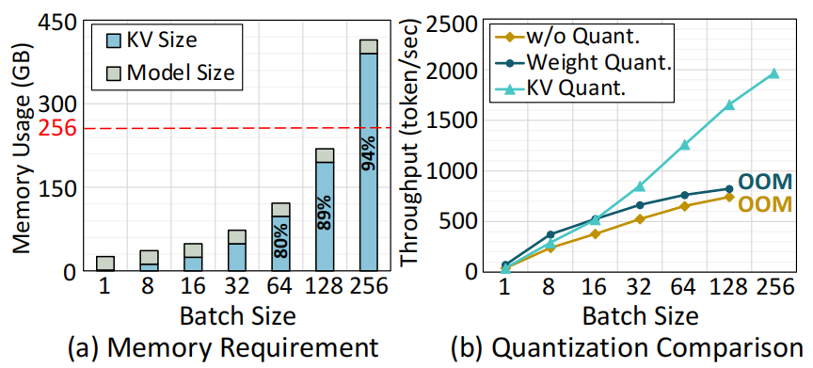
KV Cache Quantization
KV cache dominates memory usage in large-batch inference and limits throughput scalability.
Notes:
During LLM inference, we need to store the keys and values which have already been calculated into the KV cache, to avoid recalculation. However, as batch size and context length grow, the Kv cache increases rapidly and becomes the dominant consumer of memory and also inference speed. Because LLM is auto-regressive, which means every time a new token is generated, the entire Kv cache must be pulled back from GPU main memory into on-chip SRAM, meanwhile leaving the computational cores idle. So the increasing KV cache is becoming the new memory and speed bottleneck.
Therefore, reducing the KV cache size in LLMs while preserving model performance is crucial.
Next i am going to introduce two papers focusing on addressing this problem using quantization for Kv cache. The first paper is KIVI: A Tuning-Free Asymmetric 2bit Quantization for KV Cache, published on ICML 2024. This paper tries to quantize the kv cache aggressively to a extremely low-bitprecision -- only 2 bits,to reduce the memory footprint of kv cache and improve the inference speed.
But most prior quantization work has concentrated on weight quantization to accelerate LLMinference.
However, as shown in Figure a, while the memory usage for model weights remains constant as batch size grows, but the KV cache size increases rapidly and soon dominates total device memory. Figure b further demonstrates that 4-bit weight quantization gains only minimal performance improvement in batched scenarios, whereas 4-bit KV cache quantization delivers much larger gains. So the KV cache quantization is much more important than weight quantization, especially in batched inference

Slide 18
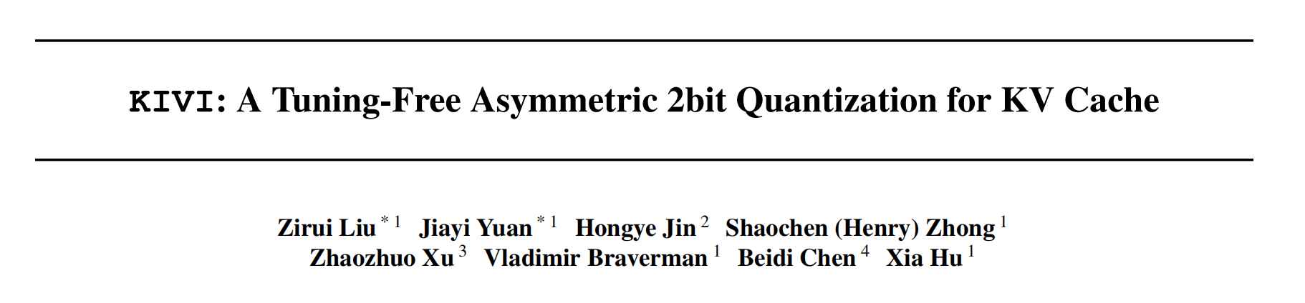
ICML 2024
Notes:
Thanks to HaoDong for introducing quantization methods in large language model training. Now, I will talk about the quantization on the KV cache during LLM inference.
During LLM inference, we need to store the keys and values which have already been calculated into the KV cache, to avoid recalculation. However, as batch size and context length grow, the Kv cache increases rapidly and becomes the dominant consumer of memory and also inference speed. Because LLM is auto-regressive, which means every time a new token is generated, the entire Kv cache must be pulled back from GPU main memory into on-chip SRAM, meanwhile leaving the computational cores idle. So the increasing KV cache is becoming the new memory and speed bottleneck.
Therefore, reducing the KV cache size in LLMs while preserving model performance is crucial.
Next i am going to introduce two papers focusing on addressing this problem using quantization for Kv cache. The first paper is KIVI: A Tuning-Free Asymmetric 2bit Quantization for KV Cache, published on ICML 2024. This paper tries to quantize the kv cache aggressively to a extremely low-bitprecision -- only 2 bits,to reduce the memory footprint of kv cache and improve the inference speed.

Slide 19
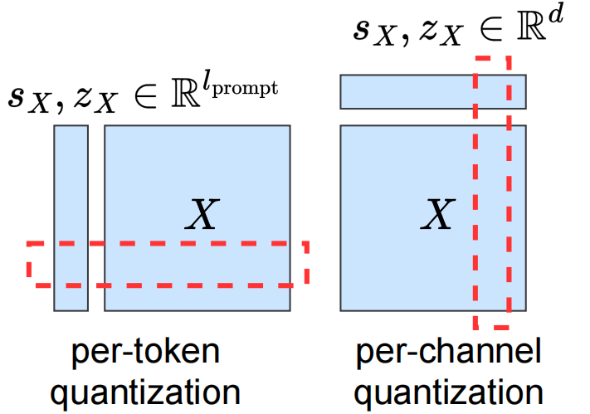
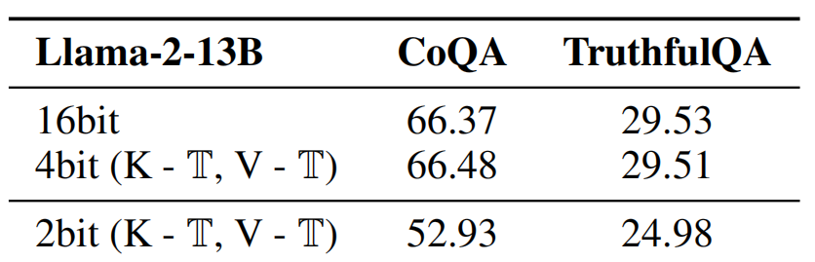
KIVI: A Tuning-Free Asymmetric 2bit Quantization for KV Cache
Challenge
When using the per-token quantization to both key and value caches, INT4 precision can
maintain accuracy. However, reducing it to INT2 results in a notable accuracy drop.
Notes:
First, let't talk about two different quantization granularity for kv cache. The left one of the plot is per-token quantization, each row of the tensor is a token, per-token quantization quantize each token sequentially along the token dimension. The right is the per-channel quantization, each column of the tensor is a channel, per-channel quantization quantize each channel individually.
The previous works on quantization for kv cache usually use per-token quantization for both key and value caches because of the streaming nature of kv cache. What's the streaming nature of kv cache? KV cache is a streaming data structure. Each time we input a new token to LLM, the corresponding key and value will
be appended to the kv cache, keeping the kv cache consistently grow, which means the number of the rows in this tensor will keep growing.
If we use the per-token quantization, every time a new key and value arrives, we can directly quantize them per-token and append the quantized kv entry into the kv cache. But if we use the per-channel quantization for kv cache, every time a new key and value arrives, we have to modify previous quantized KV cache along the channel dimension, which introduces a new overhead.
So previous works onquantization for kv cache usually use per-token quantization for both the keys and values .
And we can see from the table: With per-token quantization, using INT4 precision generally maintains model accuracy. However, when the precision is further reduced to INT2, there is a noticeable drop in accuracy, which means the previous per-token quantization on keys and values can't be applied to the low-bit precision

Slide 20
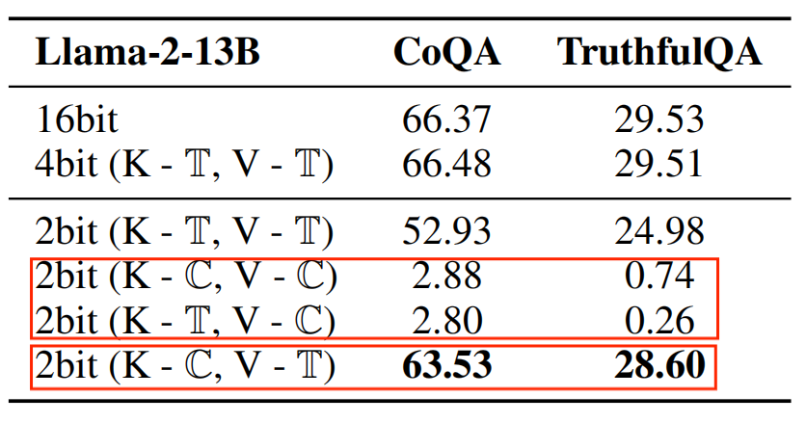
KIVI: A Tuning-Free Asymmetric 2bit Quantization for KV Cache
Quantization granularity
Key cache should be quantized per-channel and value cache should be quantized per token.
Notes:
So to address this problem, the paper explores different quantization granularity for keys and values :
From the table,we can observe that:
1. When the value cache is quantized per-channel, accuracy drops significantly, no matter how the key cache is quantized.
2. At the lower precisions INT2, the best accuracy is achieved by quantizing the key cache per-channel and the value cache per-token.
So, why does quantizing the key cache per-channel and the value cache per-token yield the best results at low precision?
And next we will find out the reasons behind it

Slide 21
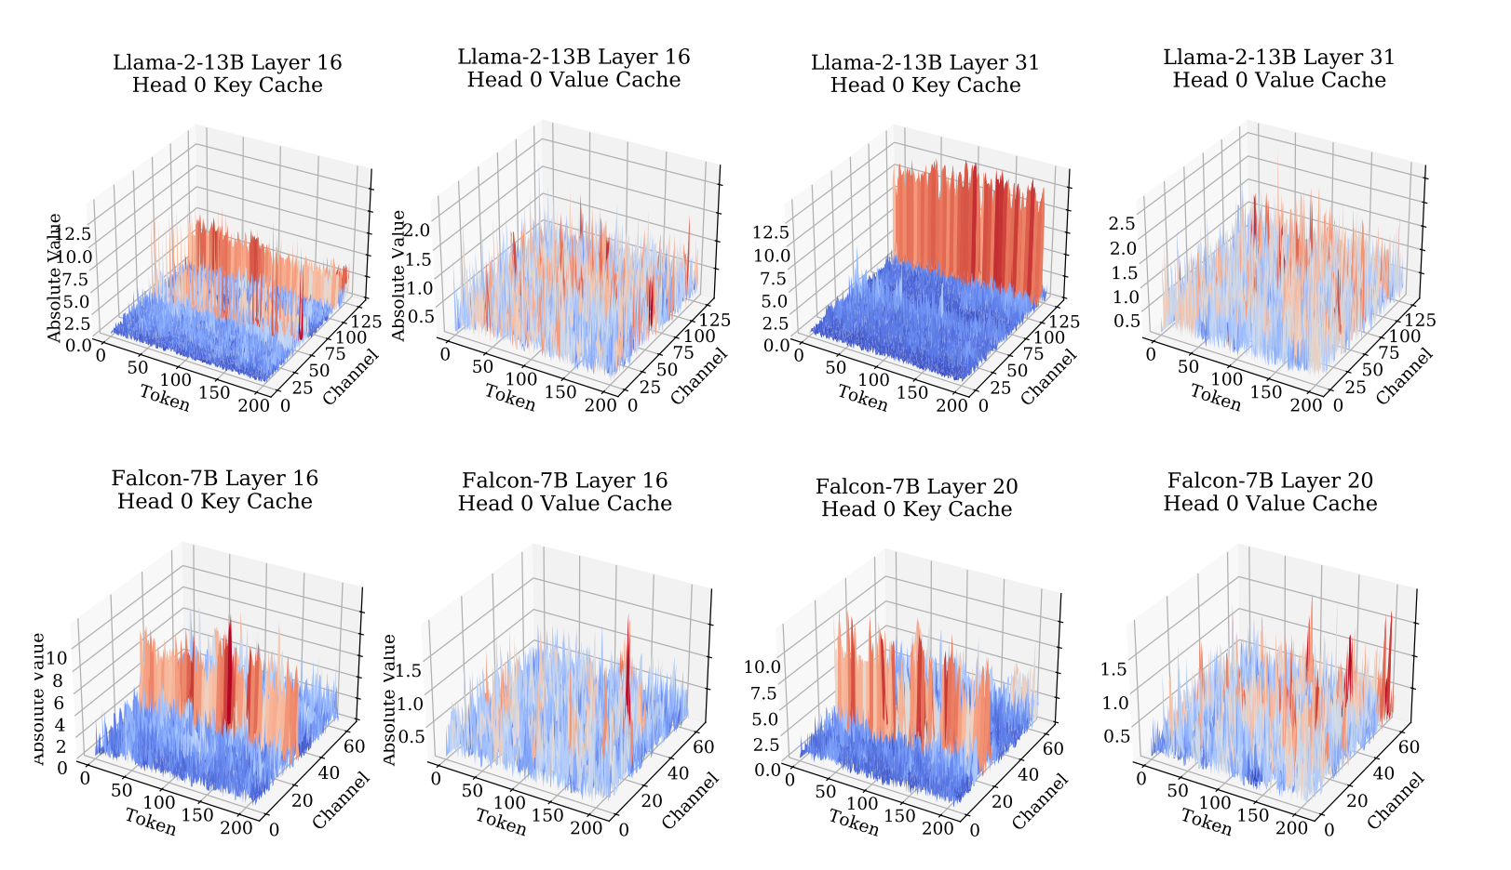
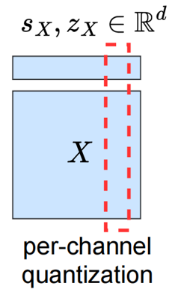
KIVI: A Tuning-Free Asymmetric 2bit Quantization for KV Cache
Why key cache should be quantized per-channel?
In key cache, some fixed channels exhibit very large magnitudes, whereas in value cache, there is no significant pattern for outliers.
Notes:
Let's look at the visualization of key and value distribution across different models and different layers.
For the key cache, we notice that certain channels exhibit very large magnitudes which are also called outliers. In this case, if we use the per-token quantization for key cache, the large outliers dominate the quantization range,leading to large quantization error for other non-outlier channels. But if we use per-channel quantization for the key cache, the quantization error is confine to each channel and does not affect the other channels. So using per-channel quantization for keys helps maintain overall accuracy, especially when some channels contain extreme outliers.
Unlike the key cache, the value cache doesn’t have strong outliers in specific channels. So what's the reason it’s better to quantize the value cache per token.

Slide 22
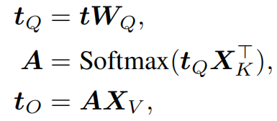
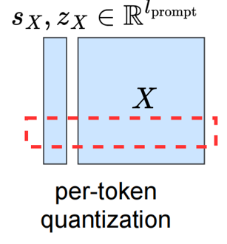
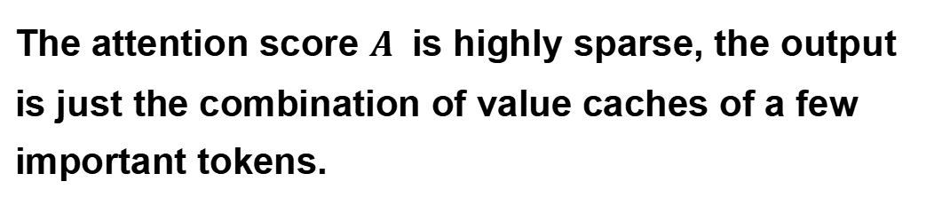
KIVI: A Tuning-Free Asymmetric 2bit Quantization for KV Cache
Why value cache should be quantized per-token?
The attention score $A^{ }$ is highly sparse, the output is just the combination of value caches of a few important tokens.
attention output calculation
Notes:
This is because the attention output is the weighted sum of value cache across various tokens, with the weights being the attention scores. Since the attention score is highly sparse, the output is just the combination of value caches of a few important tokens. The per-token quantization can confine the error to each individual token. Thus, quantizing other tokens does not affect the accuracy of important tokens.

Slide 23
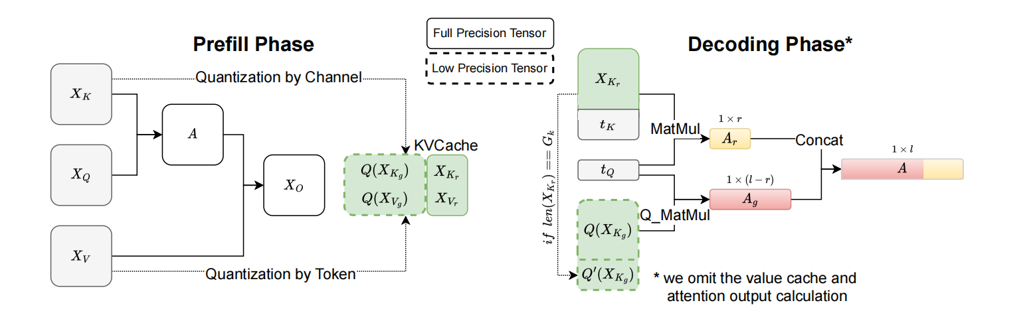
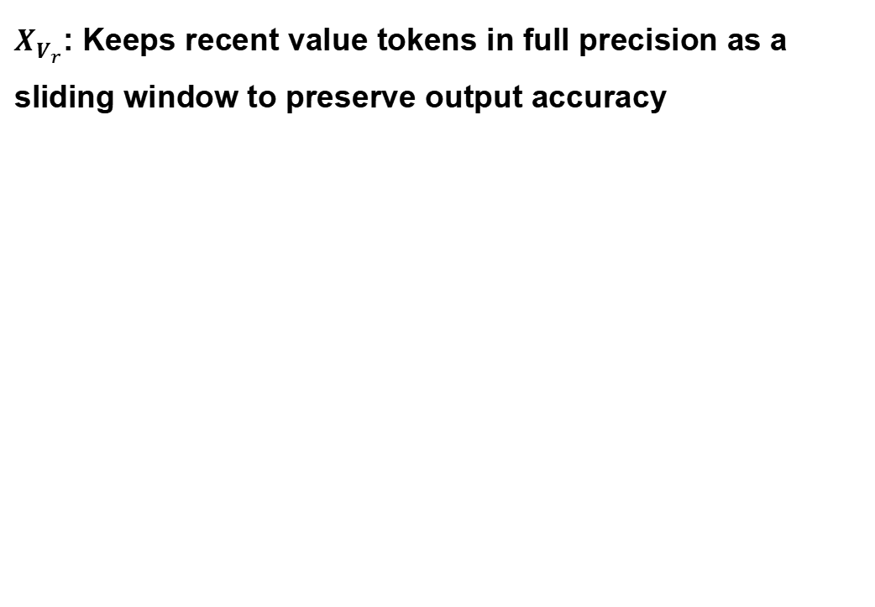
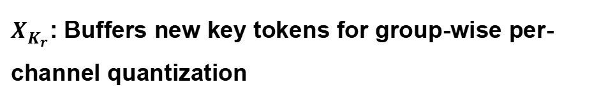
KIVI: A Tuning-Free Asymmetric 2bit Quantization for KV Cache
Overview
$X_{K_{r}}^{ }$: Buffers new key tokens for group-wise per-channel quantization
$X_{V_{r}}^{ }$: Keeps recent value tokens in full precision as a sliding window to preserve output accuracy
Notes:
So based on the previous analysis, the optimal approach is to quantize the key cache perchannel and the value cache per token.
However, per-channel quantization for key cache introduces a new challenge. As we mentioned before, when a new kv entry arrives, the per-channel quantization requires modifying the previous quantized kv cache, which does not align well with the streaming nature of the kv cache.
To address this, KIVI proposes a system design to splits the key cache into two parts. The first part is the grouped key cache, which consists of several groups, each group containing a fixed number of keys. We use per-channel quantization to quantize each group to 2 bits individually.
The second part is the residual key cache, which includes remaining keys whose number is not enough form a complete group. We keep residual key cache in full precision. And during the decoding phase, we add the newly keys to the residual key cache. Once the number of residual key cache can form a complete group, we quantize the residual key cache and move them to the grouped key cache.
Through this design, we can address the conflict between per-channel quantization and the streaming nature of key cache.
The value cache uses a similar two-part approach. Most of the value cache is divided into groups and quantized per token to 2 bits, saving memory. And the most recent R tokens are kept in full precision as a "residual window." ,which is like a sliding windows. As new tokens are generated, this window slides forward: oldest token in the window are quantized and moved to the grouped cache, while the newest tokens stay in full precision. This way, KIVI keeps the most important, recent value information accurate , while still compressing the rest of the cache to save memory and speed up inference.

Slide 24
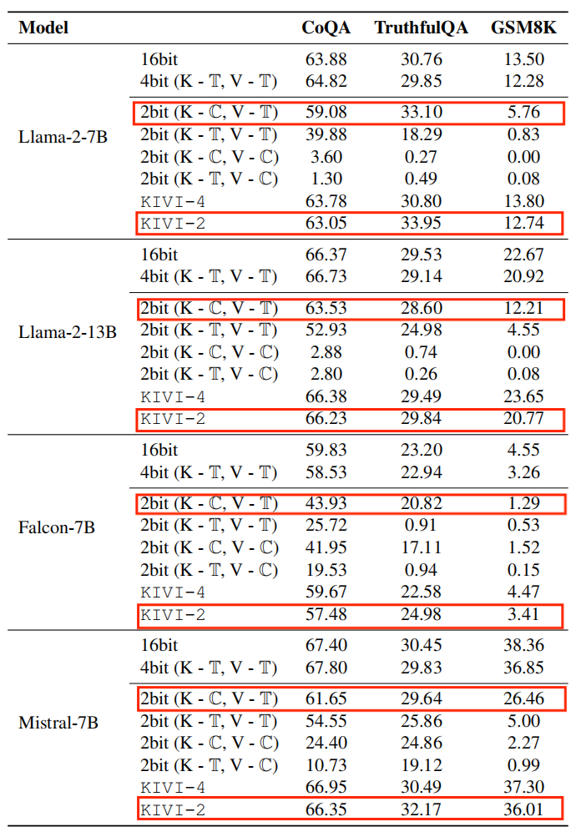
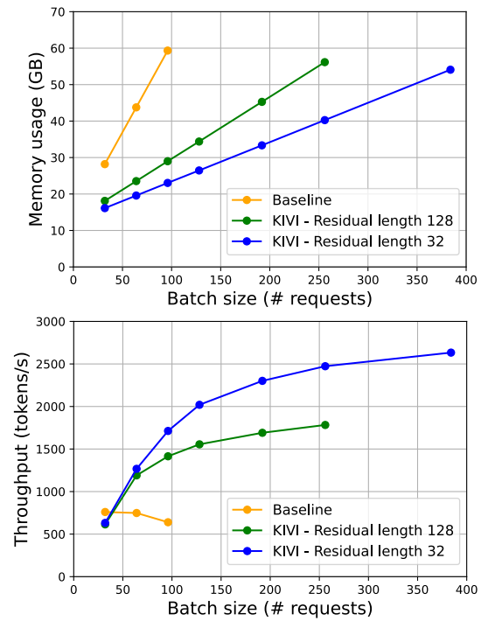
KIVI: A Tuning-Free Asymmetric 2bit Quantization for KV Cache
Evaluation
Notes:
The left experimental results show that the “2-bit (key per-channel, value per-token)” configuration consistently delivers the best performance among all tested quantization schemes, confirming our earlier analysis. However, for challenging generation tasks such as the math-reasoning task GSM8K, simple “2-bit (key per-channel, value per-token)” quantization leads to a significant drop in accuracy compared to full precision.
KIVI address this problem and maintain the model accuracy, which means the residual part is essential for preserving accuracy on difficult tasks like mathematical reasoning.
The right experimental results, KIVI compresses the size of kv cache and achieves up to a 4× increase in batch size and a 2.35× to 3.47× improvement in throughput, all while maintaining similar maximum memory usage.
So KIVI achieves improving the inference speed while maintaining the model performance through well-designed quantization for kv cache.
This is the end of the first paper.

Slide 25
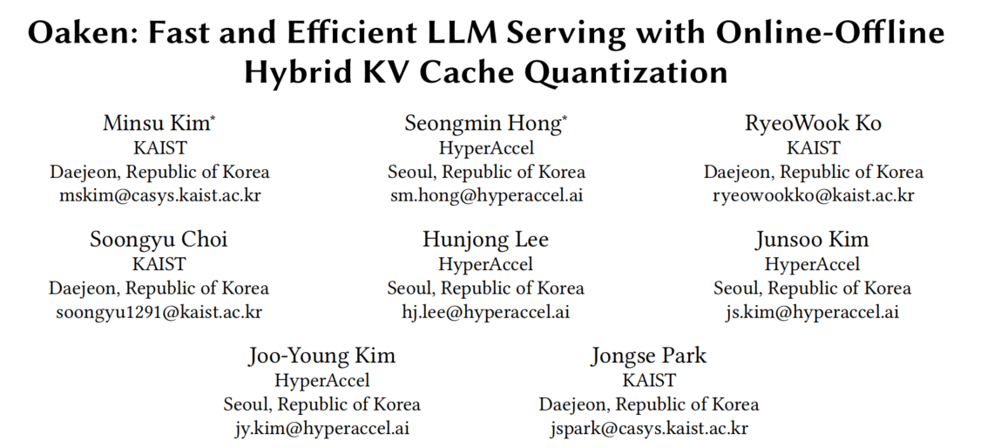
ISCA 2025
Notes:
And the second paper we are going to introduce is: Oaken: Fast and Efficient LLM Serving with Online-Offline Hybrid KV Cache Quantization, published at ISCA 2025. This work tried to achieves both high accuracy and high performance by co-designing kv cache quantization algorithms and hardware for batched-inference scenarios.

Slide 26
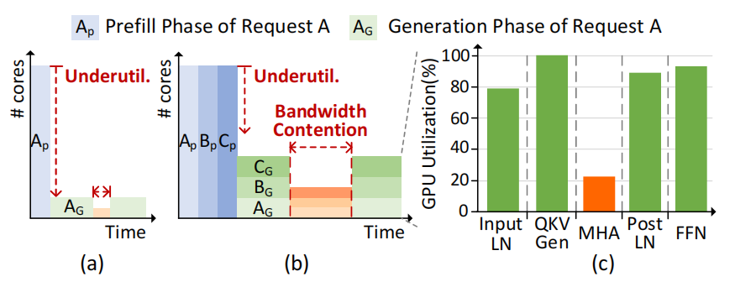
Oaken: Fast and Efficient LLM Serving with Online-Offline Hybrid KV Cache Quantization
Challenge
While increasing batch size improves hardware utilization, it also worsens the KV cache problem
Notes:
The figure is the utilization of compute core in different inference situations. The figure(a) is the Single-instance inference,which means processing one request at a time. During prefill, multiple tokens are processed in parallel, keeping computational cores busy and utilized well. But in the generation phase, tokens are generated one by one each time, leaving most computational cores idle whose utilization rate is very low.
To improve core utilization, we increase the batch size which is also called batched inference. The figure(b) is the batched inference meaning LLM serve multiple requests simultaneously. • Batched inference: However, during the generation phase, even with batched requests, core utilization improves a little bit but still remains under-utilization and latency increases due to bandwidth contention.
Figure (c) shows GPU core utilization during the generation phase , highlighting that underutilization mainly results from multi-head attention operations because of the kv cache. This happens because kv cache from attention layers cannot be shared across different requests, so each request in the attention layer uses only a limited number of compute cores.
So reducing the size of kv cache with quantization is crucial.

Slide 27
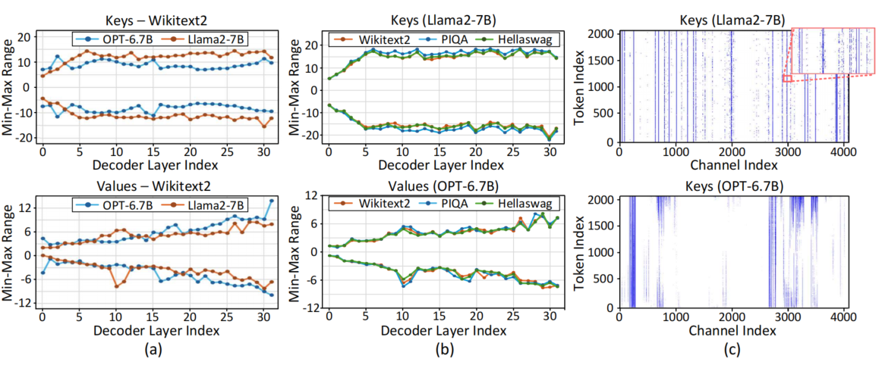
Oaken: Fast and Efficient LLM Serving with Online-Offline Hybrid KV Cache Quantization
Observation
Min-Max range varies
Insensitivity to data
Scattered outliers
Notes:
To further explore the quantization for kv cache, Oaken examines distribution of the KV cache across several LLMs and datasets, which will guide Oaken’s quantization approach.
First,figure(a) shows that when we compare KV cache values across different models and decoder layers, we find that the minimum and maximum values can vary a lot—not only just between models, but also among different layers within the same model.
Second,figure(b) shows that when we compare the KV cache value ranges for the Llama2-7B model across different datasets, the value range stays consistent no matter which dataset we use.
Based on the first two observations, Oaken can analyse the distribution of each layer offline and determine the appropriate thresholds and scaling factors for kv cache quantization without the need for online adjustment during inference. This approach reduces online computation overhead while ensuring quantization accuracy.
Third, as shown in figure (c), there are some outliers in some specific channel, which is similar to the first paper. Differently, we find that outliers are not all in the specific channels can also be scattered throughout other channels. If we use just one quantization scale for the whole vector or group, these scattered outliers can cause significant accuracy loss.

Slide 28
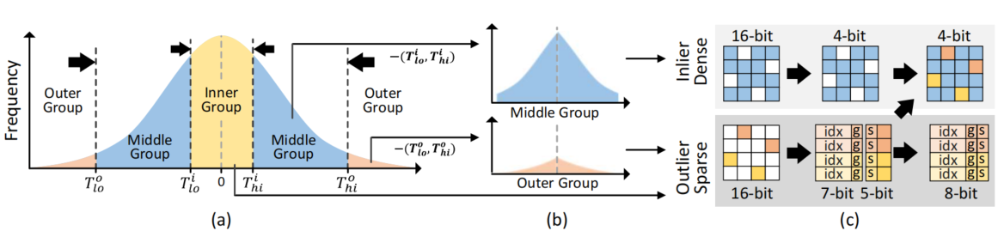
Oaken: Fast and Efficient LLM Serving with Online-Offline Hybrid KV Cache Quantization
Oaken’s KV Quantization Algorithm
Notes:
After previous observation, this is the overview of Oaken’s Quantization for kv cache ,trying to maximize KV cache compression while preserving accuracy and minimizing runtime overhead. Let’s break down Oaken’s quantization method into three key steps

Slide 29
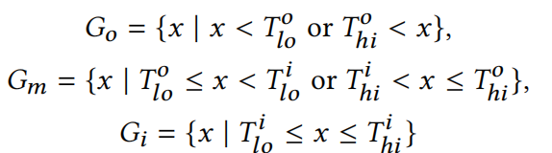
Oaken: Fast and Efficient LLM Serving with Online-Offline Hybrid KV Cache Quantization
(a) Threshold-based Online-Offline Hybrid Quantization
Separate KV values into inlier and outlier groups using offline-profiled thresholds to enable efficient online quantization with minimal accuracy loss.
Notes:
LLM quantization methods highlight that both large values and small values near zero can significantly affect model accuracy. Large values, if not handled properly, can dominate the quantization range and introduce substantial errors, while small values are prone to vanishing due to underflow, also leading to increased quantization error.
Oaken addresses these challenges by splitting each per-token KV vector into three groups: the outer group (large outliers), the inner group (small outliers whose value is near zero), and the middle group (inliers, where most values are concentrated). The boundaries for these groups are determined by four thresholds, which are profiled offline by collecting statistics from each decoder layer. This offline profiling eliminates the need for expensive online operations like sorting or top-K selection during inference.
During inference, Oaken uses these pre-computed thresholds to quickly assign each value to its corresponding group. For each group, Oaken computes the quantization scaling factor for each group online, and quantizes the value within each group accordingly.

Slide 30
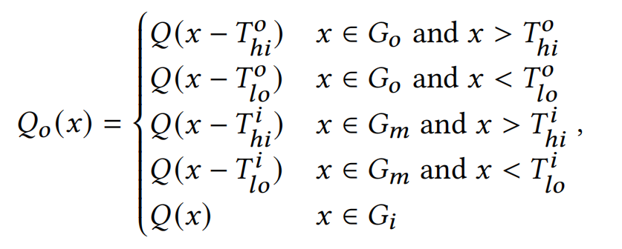
Oaken: Fast and Efficient LLM Serving with Online-Offline Hybrid KV Cache Quantization
(b) Group-Shift Quantization
Mixed Precision for outliers: 1 bit + 6 bit + 16 bit = 23 bits per outlier
Oaken for outliers: 1 bit + 6 bit + 5 bit = 12 bits per outlier
Notes:
The first step mitigates quantization accuracy loss by splitting values into three groups: outer, middle,and inner group. However, this approach poses a new challenge. While grouping helps isolate outliers, quantizing them remains challenging due to their wide value range. Previous methods often addressed this by using mixed precision—such as FP16 for outliers and INT4 for inliers—but this approach introduces significant storage overhead (up to 23 bits per outlier) and adds hardware complexity, especially as the proportion of outliers increases. These extra costs make it difficult to efficiently balance accuracy and performance.
Oaken overcomes this with a hardware-friendly group-shift quantization technique. The core idea is to shift the value range of each group using thresholds obtained from offline profiling, effectively narrowing the spread of values before quantization. For the outer group (large outliers), values above the upper threshold are shifted down, and those below the lower threshold are shifted up. The same approach can be applied to the middle group (inliers) if needed. This shifting concentrates values within a smaller range, making it possible to quantize even outliers to a lower bitwidth (e.g., 5 bits) without significant information loss.
With group-shift quantization, Oaken quantizes the middle group into 4 bits, and both the inner and outer groups into 5 bits. This approach minimizes quantization loss, avoids mixed_x0002_precision complexity, and enables efficient, low-bitwidth storage for all groups

Slide 31
Oaken: Fast and Efficient LLM Serving with Online-Offline Hybrid KV Cache Quantization
(c) Fused Dense-and-Sparse Encoding
Mixed Precision for outliers: 1 bit + 6 bit + 16 bit = 23 bits per outlier
Oaken for outliers: 1 bit + 6 bit + 5 bit - 4 bit(stored in dense matrix) = 8 bits per outlier
Notes:
To store quantized KV cache values efficiently, Oaken adopts a fused dense-and-sparse encoding scheme. The majority of values—the inliers from the middle group—are stored densely in a matrix, while the outliers (outer and inner groups) are stored sparsely using a coordinate list (COO) format. In this scheme, the positions in the dense matrix that correspond to outliers are zeroed out.
To further reduce storage overhead, Oaken reuses these zeroed elements in the dense matrix. Specifically, four bits of each 5-bit quantized outlier are embedded directly into these zeroed dense entries. The remaining bits—6 index bits (to indicate location), 1 group bit (to distinguish group membership), and 1 sign bit—are stored in the sparse COO format.
This fused approach reduces the storage required for each outlier from 23 bits (in prior methods) to just 8 bits, significantly improving KV cache compression while maintaining memory alignment and hardware efficiency.

Slide 32
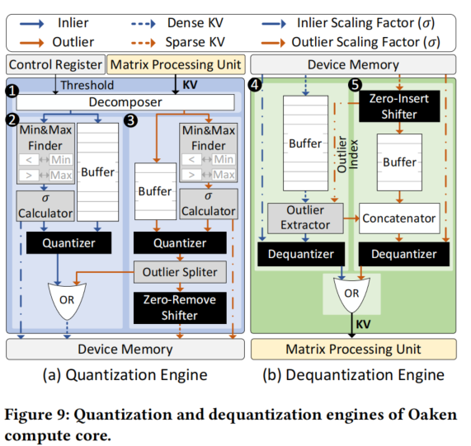
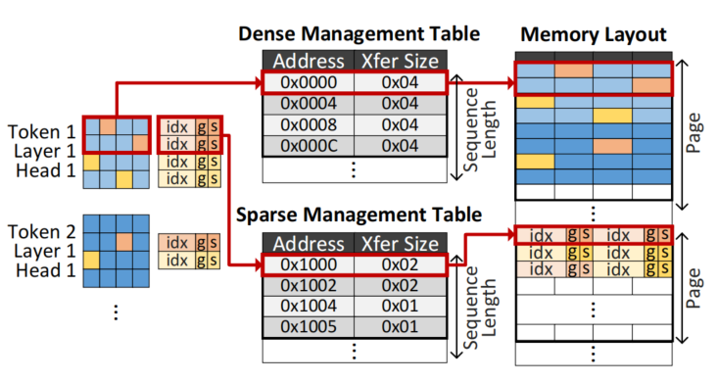
Oaken: Fast and Efficient LLM Serving with Online-Offline Hybrid KV Cache Quantization
Architecture Overview
memory management unit (MMU)
Notes:
Figure 10 shows the MMU’s operations. Its main job is to manage both dense and sparse matrices in a page-based manner, which helps fficiently handle the quantized KV cache and optimize bandwidth utilization.
Without this specialized MMU, handling variable-sized sparse matrices would require extra overhead for indexing, reshaping, and other operations, which would slow down the system.
MMU uses two separate management tables—one for dense data and another for sparse data—to track virtual-to-physical memory mappings and transfer sizes at page granularity. Dense inlier values, which are fixed-size and aligned, are stored contiguously to support burst-mode memory access, while sparse outlier values, which vary in size, are stored using a compact COO format along with indexing metadata. The MMU organizes KV cache per token, layer, and attention head, enabling efficient sequential writes and burst-mode reads across tokens. This architecture maximizes bandwidth utilization, reduces fragmentation, and supports low-latency memory access crucial for high-throughput batched inference.

Slide 33
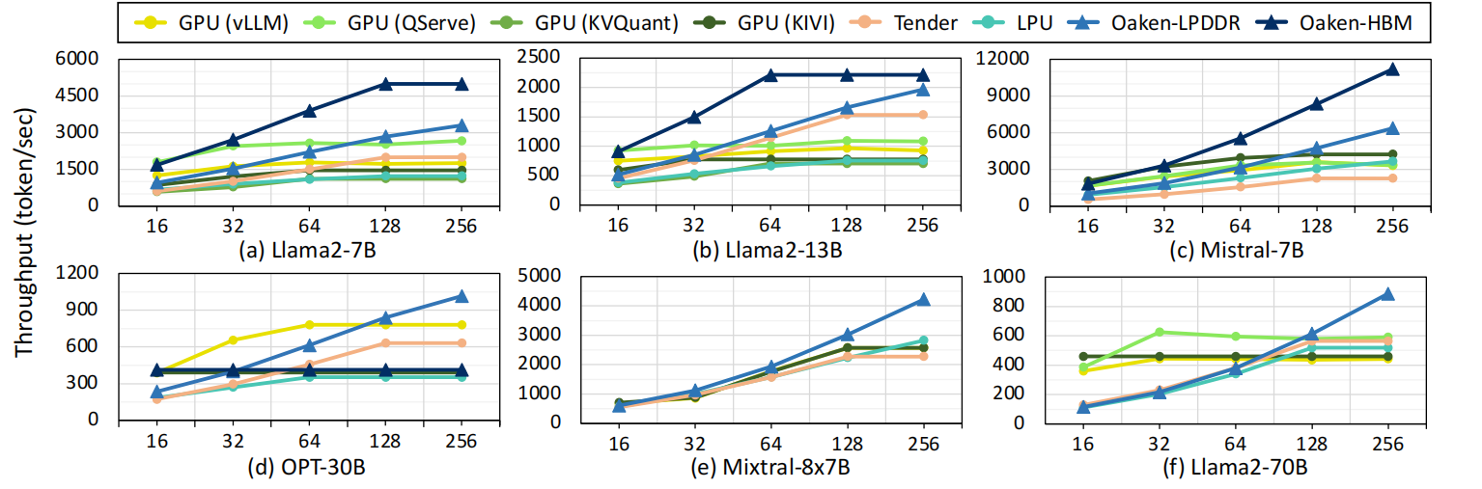
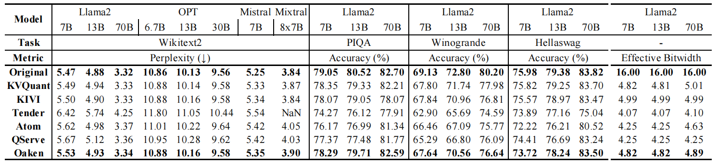
Oaken: Fast and Efficient LLM Serving with Online-Offline Hybrid KV Cache Quantization
Evaluation
Notes:
• Throughput: Oaken achieves up to 1.58× improvement over A100 GPUs and outperforms other quantized accelerators like QServe and Tender.
• Accuracy: Only 0.87% average loss, outperforming QServe and matching or exceeding Tender and Atom—while using a lower effective bitwidth.
Oaken strikes a new balance between capacity and bandwidth, enabling fast, accurate, and scalable LLM serving under real-world constraints.

Slide 34
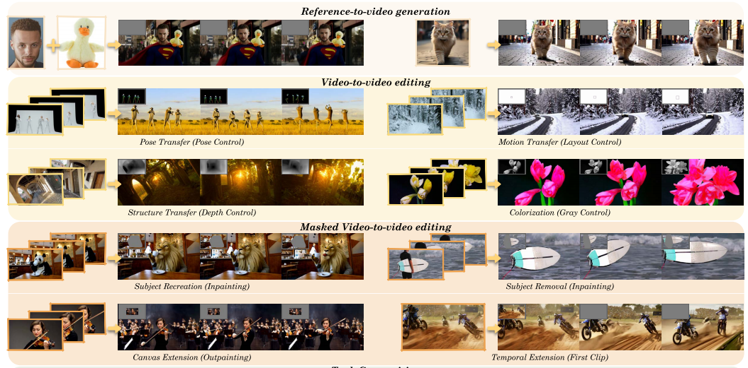
Idea: Modality-Balanced Quantization for Diffusion Model
Four Task in one model: Text-to-Video Generation, Reference-to-Video Generation, Video-to-Video Editing, Masked Video-to-Video Editing
VACE: All-in-One Video Creation and Editing, Tongyi Lab

Slide 35
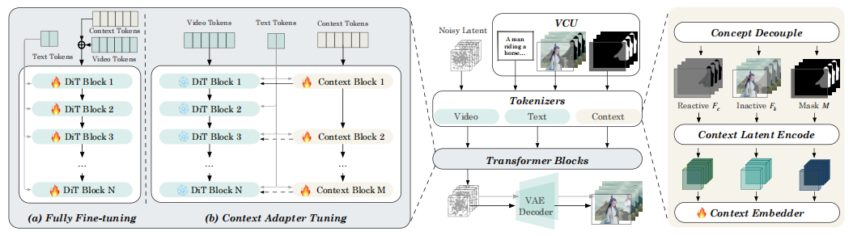
Idea: Modality-Balanced Quantization for Diffusion Model
Not all tokens are equal In LLM quantization, each text token contributes the same gradient to the quantization loss. Multi-modal tokens (text / image / video / mask) carry unequal value—allocate precision accordingly.
Not all KV-cache entries are valuable The importance of key–value pairs varies with the token’s modality. Store key-value pairs at modality-aware mixed bit-widths to trim memory with minimal accuracy drop.
VACE: All-in-One Video Creation and Editing, Tongyi Lab

